Slide 1
App server and web servers
Webserver configuration testing

Slide 2
Web server
Apache(httpd)
Nginx
Webservers will help us to manage/deploy the static websites

Slide 3
Apache configuration
Yum install httpd
Systemctl status httpd –l
ps –ef | grep httpd
Default port no : 80
Default deployment location : /var/www/html
Change port no : /etc/httpd/conf/httpd.conf

Slide 4
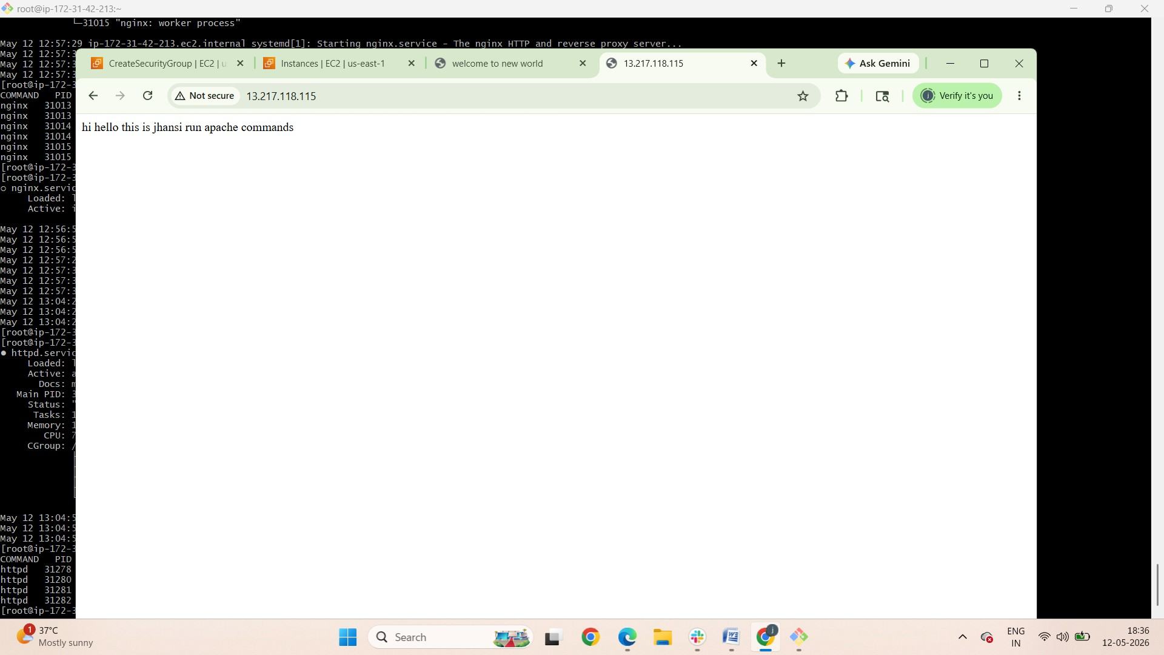

Slide 5
Nginx configuration
Yum install nginx
Systemctl start nginx
Systemctl status nginx
Ps –ef | grep nginx
Default deployment location : /usr/share/nginx
Default configuration : /etc/nginx/nginx.conf

Slide 6
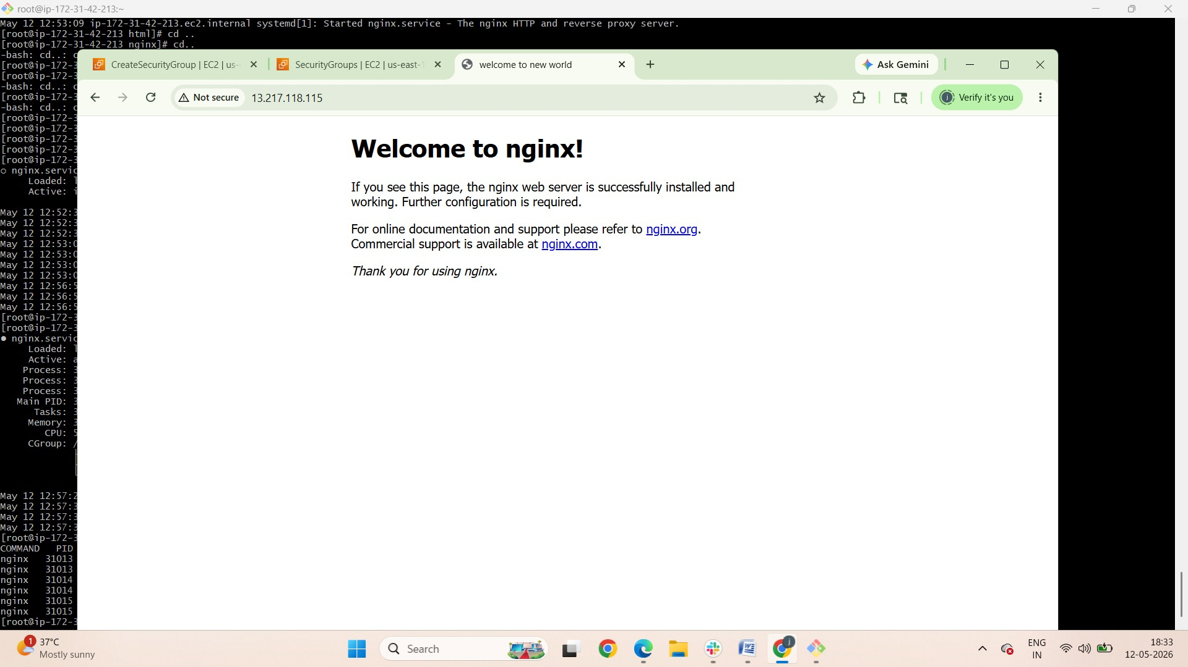

Slide 7
Appserver
It is used to deploy dynamic content
Apache tomcat
Jboss
Weblogic
Most of them used apache tomcat

Slide 8
Apache Tomcat
Pre-requiste : install java “yum install java”Wget “ tomcat tar file download web link”Extract apache tar fileChange directory to extracted apache tomcat directoryChange to bin directoryTo start apache tomcat service “bash startup.sh or ./startup.shOn browser check enter ip address with port number 8080Tomcat is installed page is displayed.

Slide 9
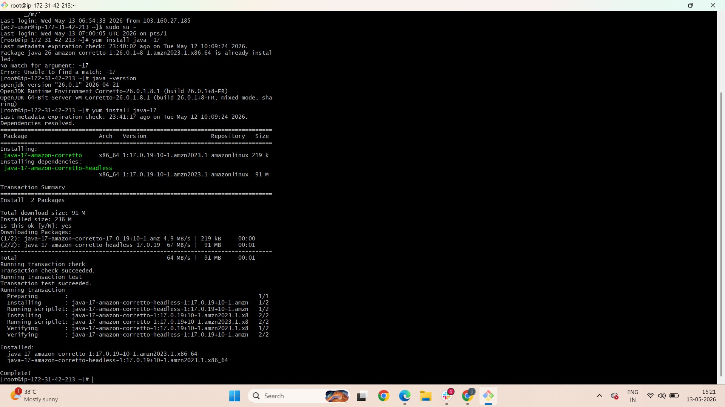
Apache Tomcat Configuration
Notes:
Install java-17Yum install java-17

Slide 10
Tomcat installation
Download file from tomcat websitehttps://dlcdn.apache.org/tomcat/tomcat-9/v9.0.118/bin/apache-tomcat-9.0.118.tar.gz
Cd /opt
Wget https://dlcdn.apache.org/tomcat/tomcat-9/v9.0.118/bin/apache-tomcat-9.0.118.tar.gz

Slide 11
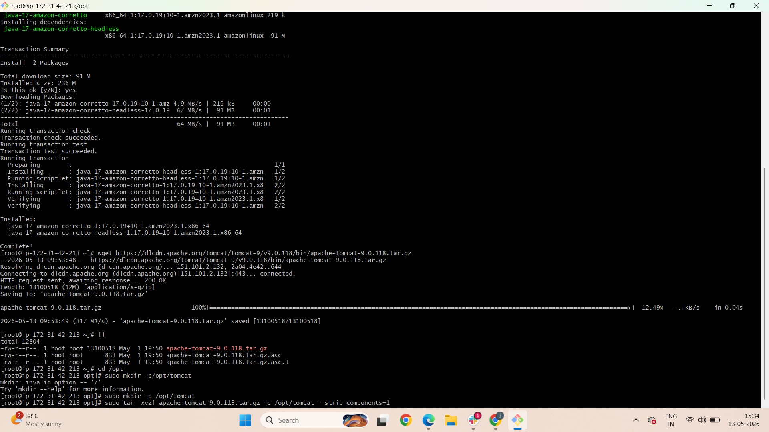

Slide 12
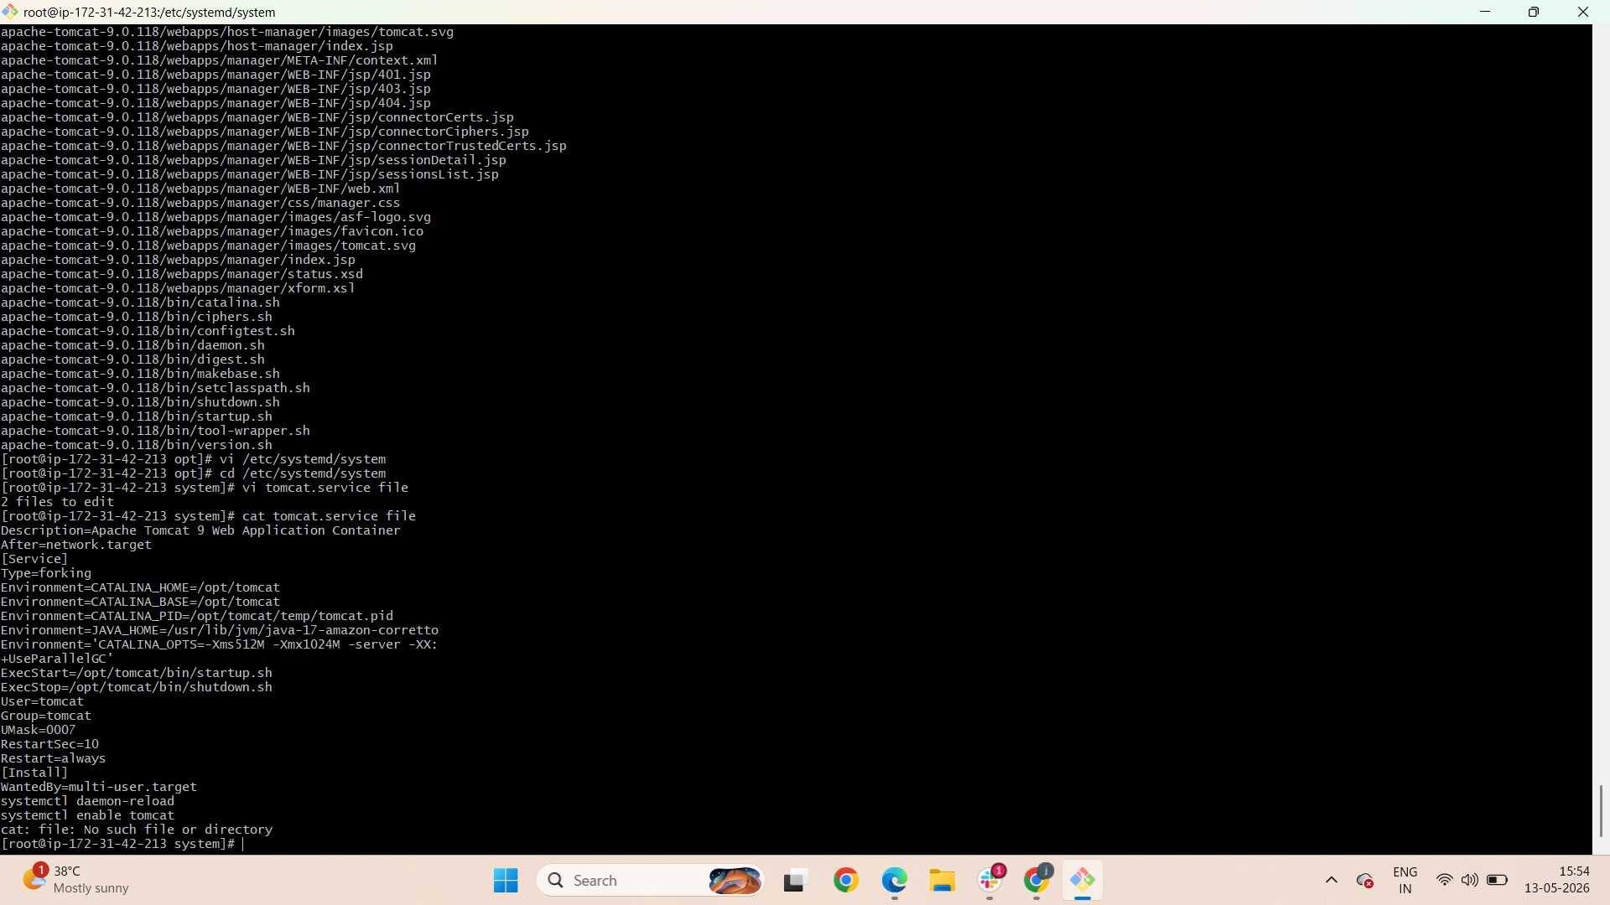

Slide 13
Tomcat Installation
Mkdir /opt/tomcat
Cd tomcat
Extract the tomcat tar file : tar -xvzf apache-tomcat-9.0.118.tar.gz

Slide 15
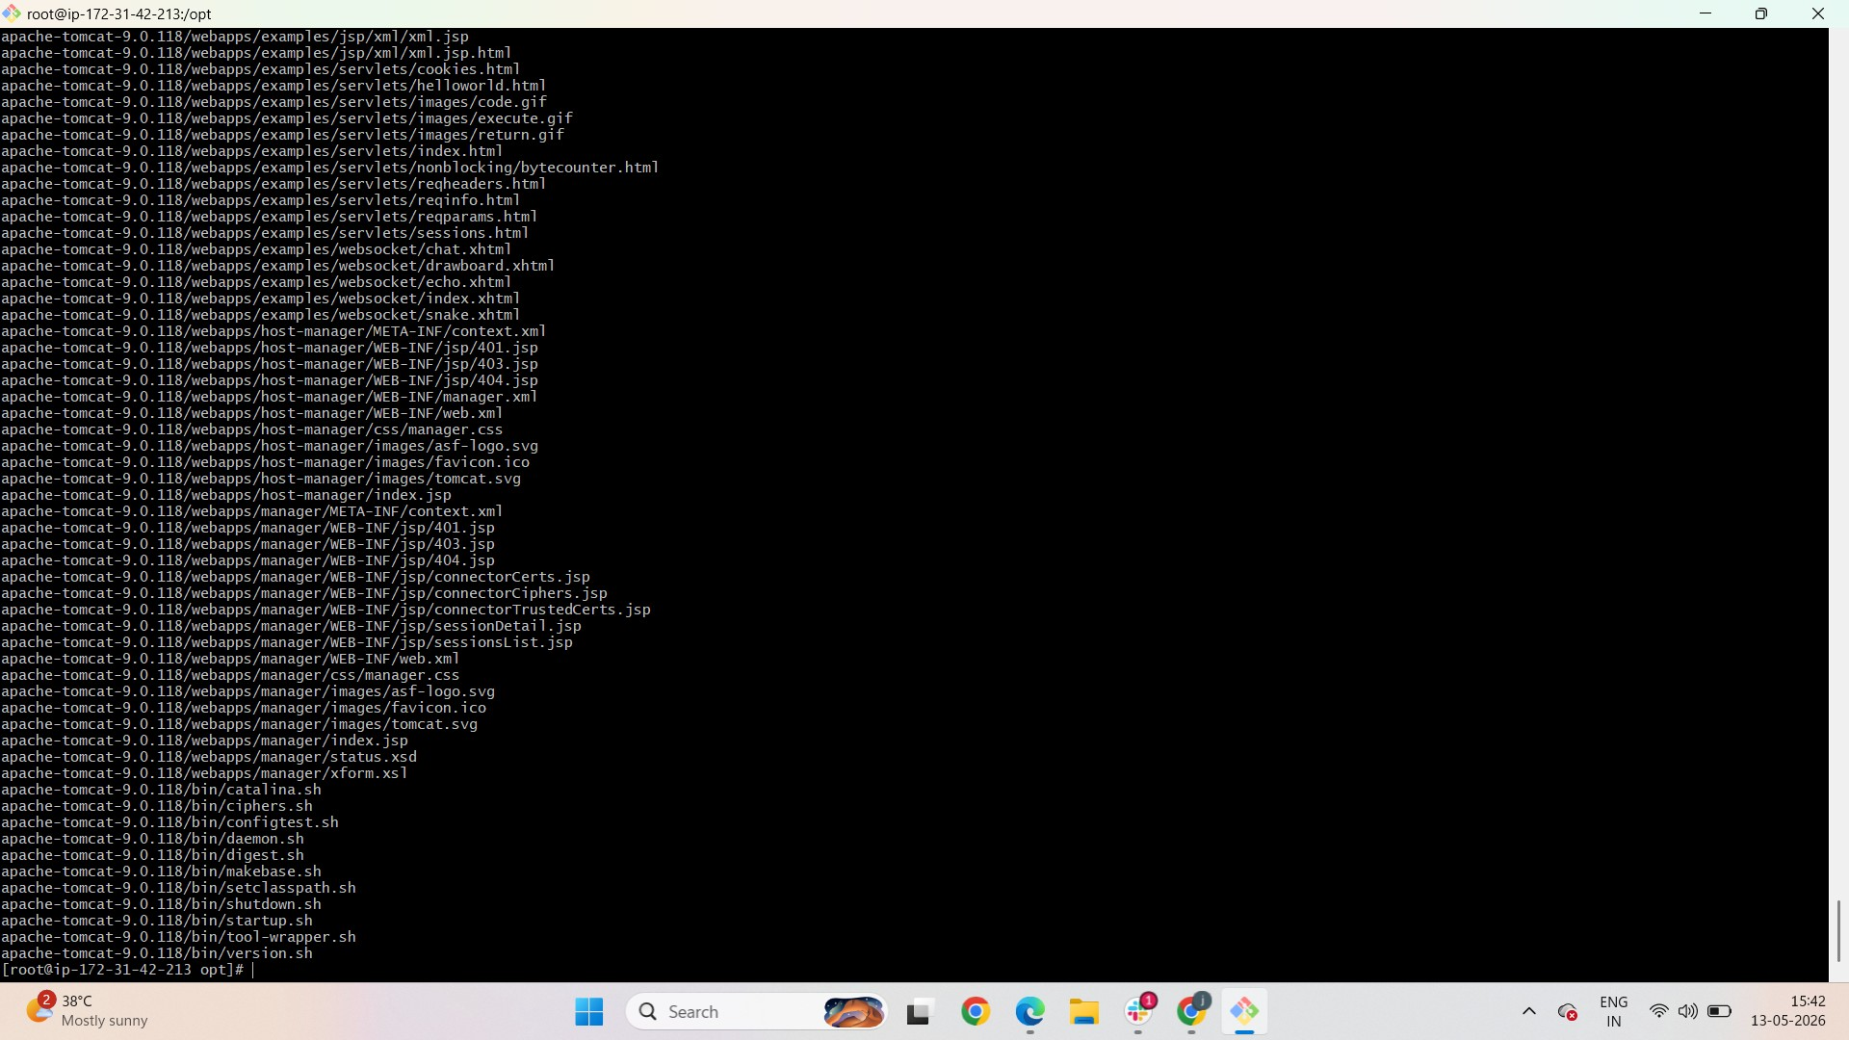

Slide 16
Service file for tomcat
Create tomcat service file
vi /etc/systemd/system/tomcat.service
add settings to the tomcat.service file

Slide 17
Create Tomcat service file
Description=Apache Tomcat 9 Web Application ContainerAfter=network.target[Service]Type=forkingEnvironment=CATALINA_HOME=/opt/tomcatEnvironment=CATALINA_BASE=/opt/tomcatEnvironment=CATALINA_PID=/opt/tomcat/temp/tomcat.pidEnvironment=JAVA_HOME=/usr/lib/jvm/java-17-amazon-correttoEnvironment='CATALINA_OPTS=-Xms512M -Xmx1024M -server -XX:+UseParallelGC'ExecStart=/opt/tomcat/bin/startup.shExecStop=/opt/tomcat/bin/shutdown.shUser=tomcatGroup=tomcatUMask=0007RestartSec=10Restart=always[Install]WantedBy=multi-user.targetsystemctl daemon-reloadsystemctl enable tomcat

Slide 18
Status of Tomcat
systemctl start tomcat
systemctl status tomcat

Slide 19
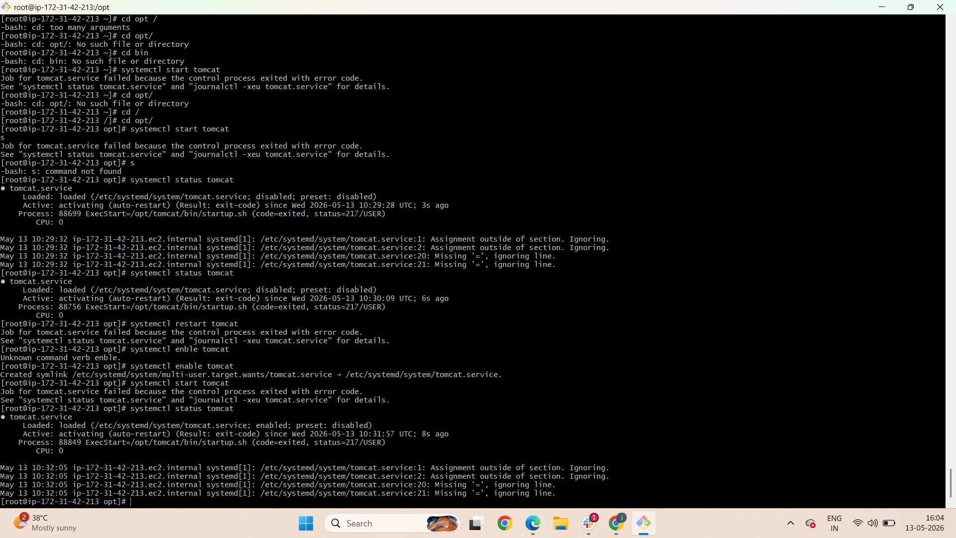

Slide 20
